Slide 1
Discussion group 2:
Emerging Applications in Industry
Chair: Dr. Vincent Poulain d'Andecy
Scribe: Ass. Prof. Muriel Visani

Slide 2
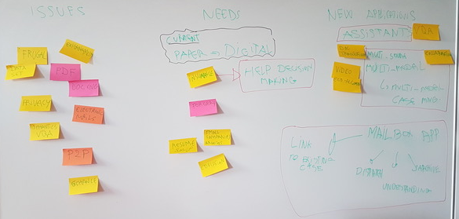
MANY THANKS TO THE LARGE AUDIENCE
Notes:
Today, application are focused on digitization process
We pointed out : issues, needs and we highlighted emerging applications

Slide 3
Concerns and issues
Document exchanges
with heterogeneous content
PDF
Emails
Exploitation issues
Explanability
Small datasets
Frugality
Interoperability
Privacy

Slide 4
Needs
Help decision making
Insurance
Forgery
Document summarization
Specificities of small companies
Need for an alternative to the PDF format / new standards?
Document exchanges
with heterogeneous content
PDF
Emails
Exploitation issues
Explanability
Small datasets
Frugality
Interoperability
Privacy

Slide 5
Current/new applications
Help decision making
Insurance
Forgery
Document summarization
Specificities of small companies
Need for an alternative to the PDF format / new standards?
Assistants
Help interactive decision, VQA,…
Multi-source/multi-modal application
Video
E-mail processing
Business case linkage
Dispatching
Smart archiving
Refactoring of current applications with ECO-Algorithms
Document exchanges
with heterogeneous content
PDF
Emails
Exploitation issues
Explanability
Small datasets
Frugality
Interoperability
Privacy

